Slide 1

Encryption and Decryption of Secret Data by Forming Cipher Text

Slide 2

Introduction to Cipher Text
Basic unit of cryptography.
Plain text before encryption, and cipher text after encryption.
Encrypted data can not be decrypted without knowing a secret key.

Slide 3

Types of Cipher Text
Caeser Cipher
Substitution Cipher
Transposition Cipher
Vigenere Cipher
RSA Cipher

Slide 4


Slide 5
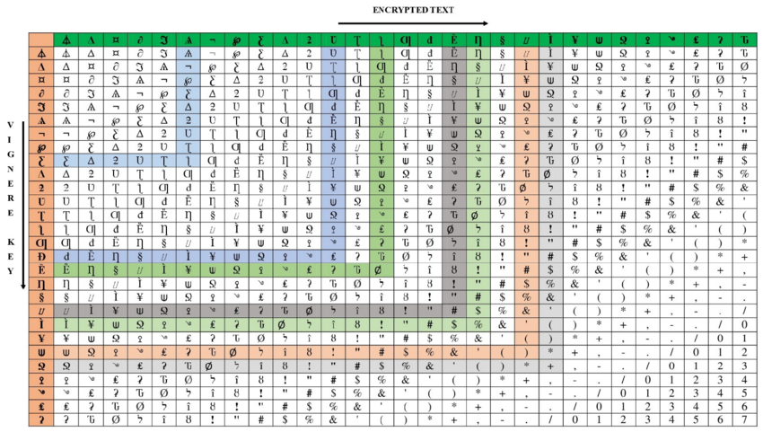
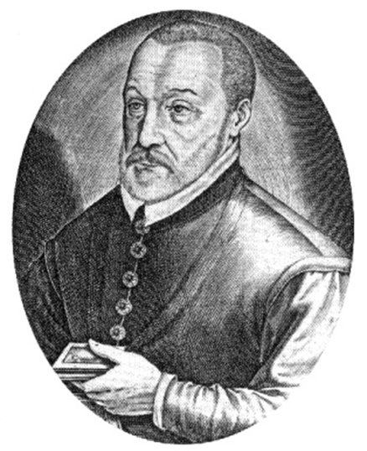
History
First used
by
Leon Battista Alberti
in 1467.
Stronger version published
by
Bhaise De Vigenere in 1553.
Most used cipher in the 18th century.
YOUR LOGO
5

Slide 6
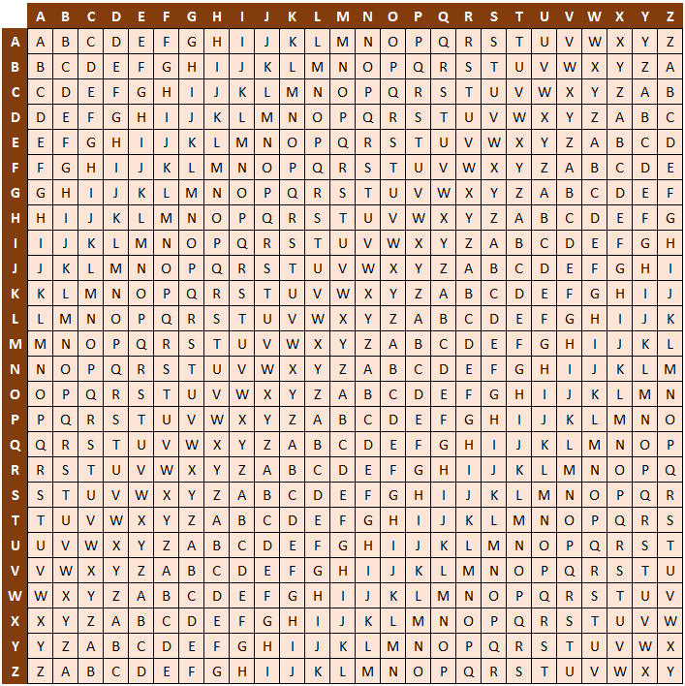
Basic Steps
6
Encrypting Data with the Key
Generating Specific Key
Forming Vigenere Matrix
Decrypting Data by
Using the Key

Slide 7
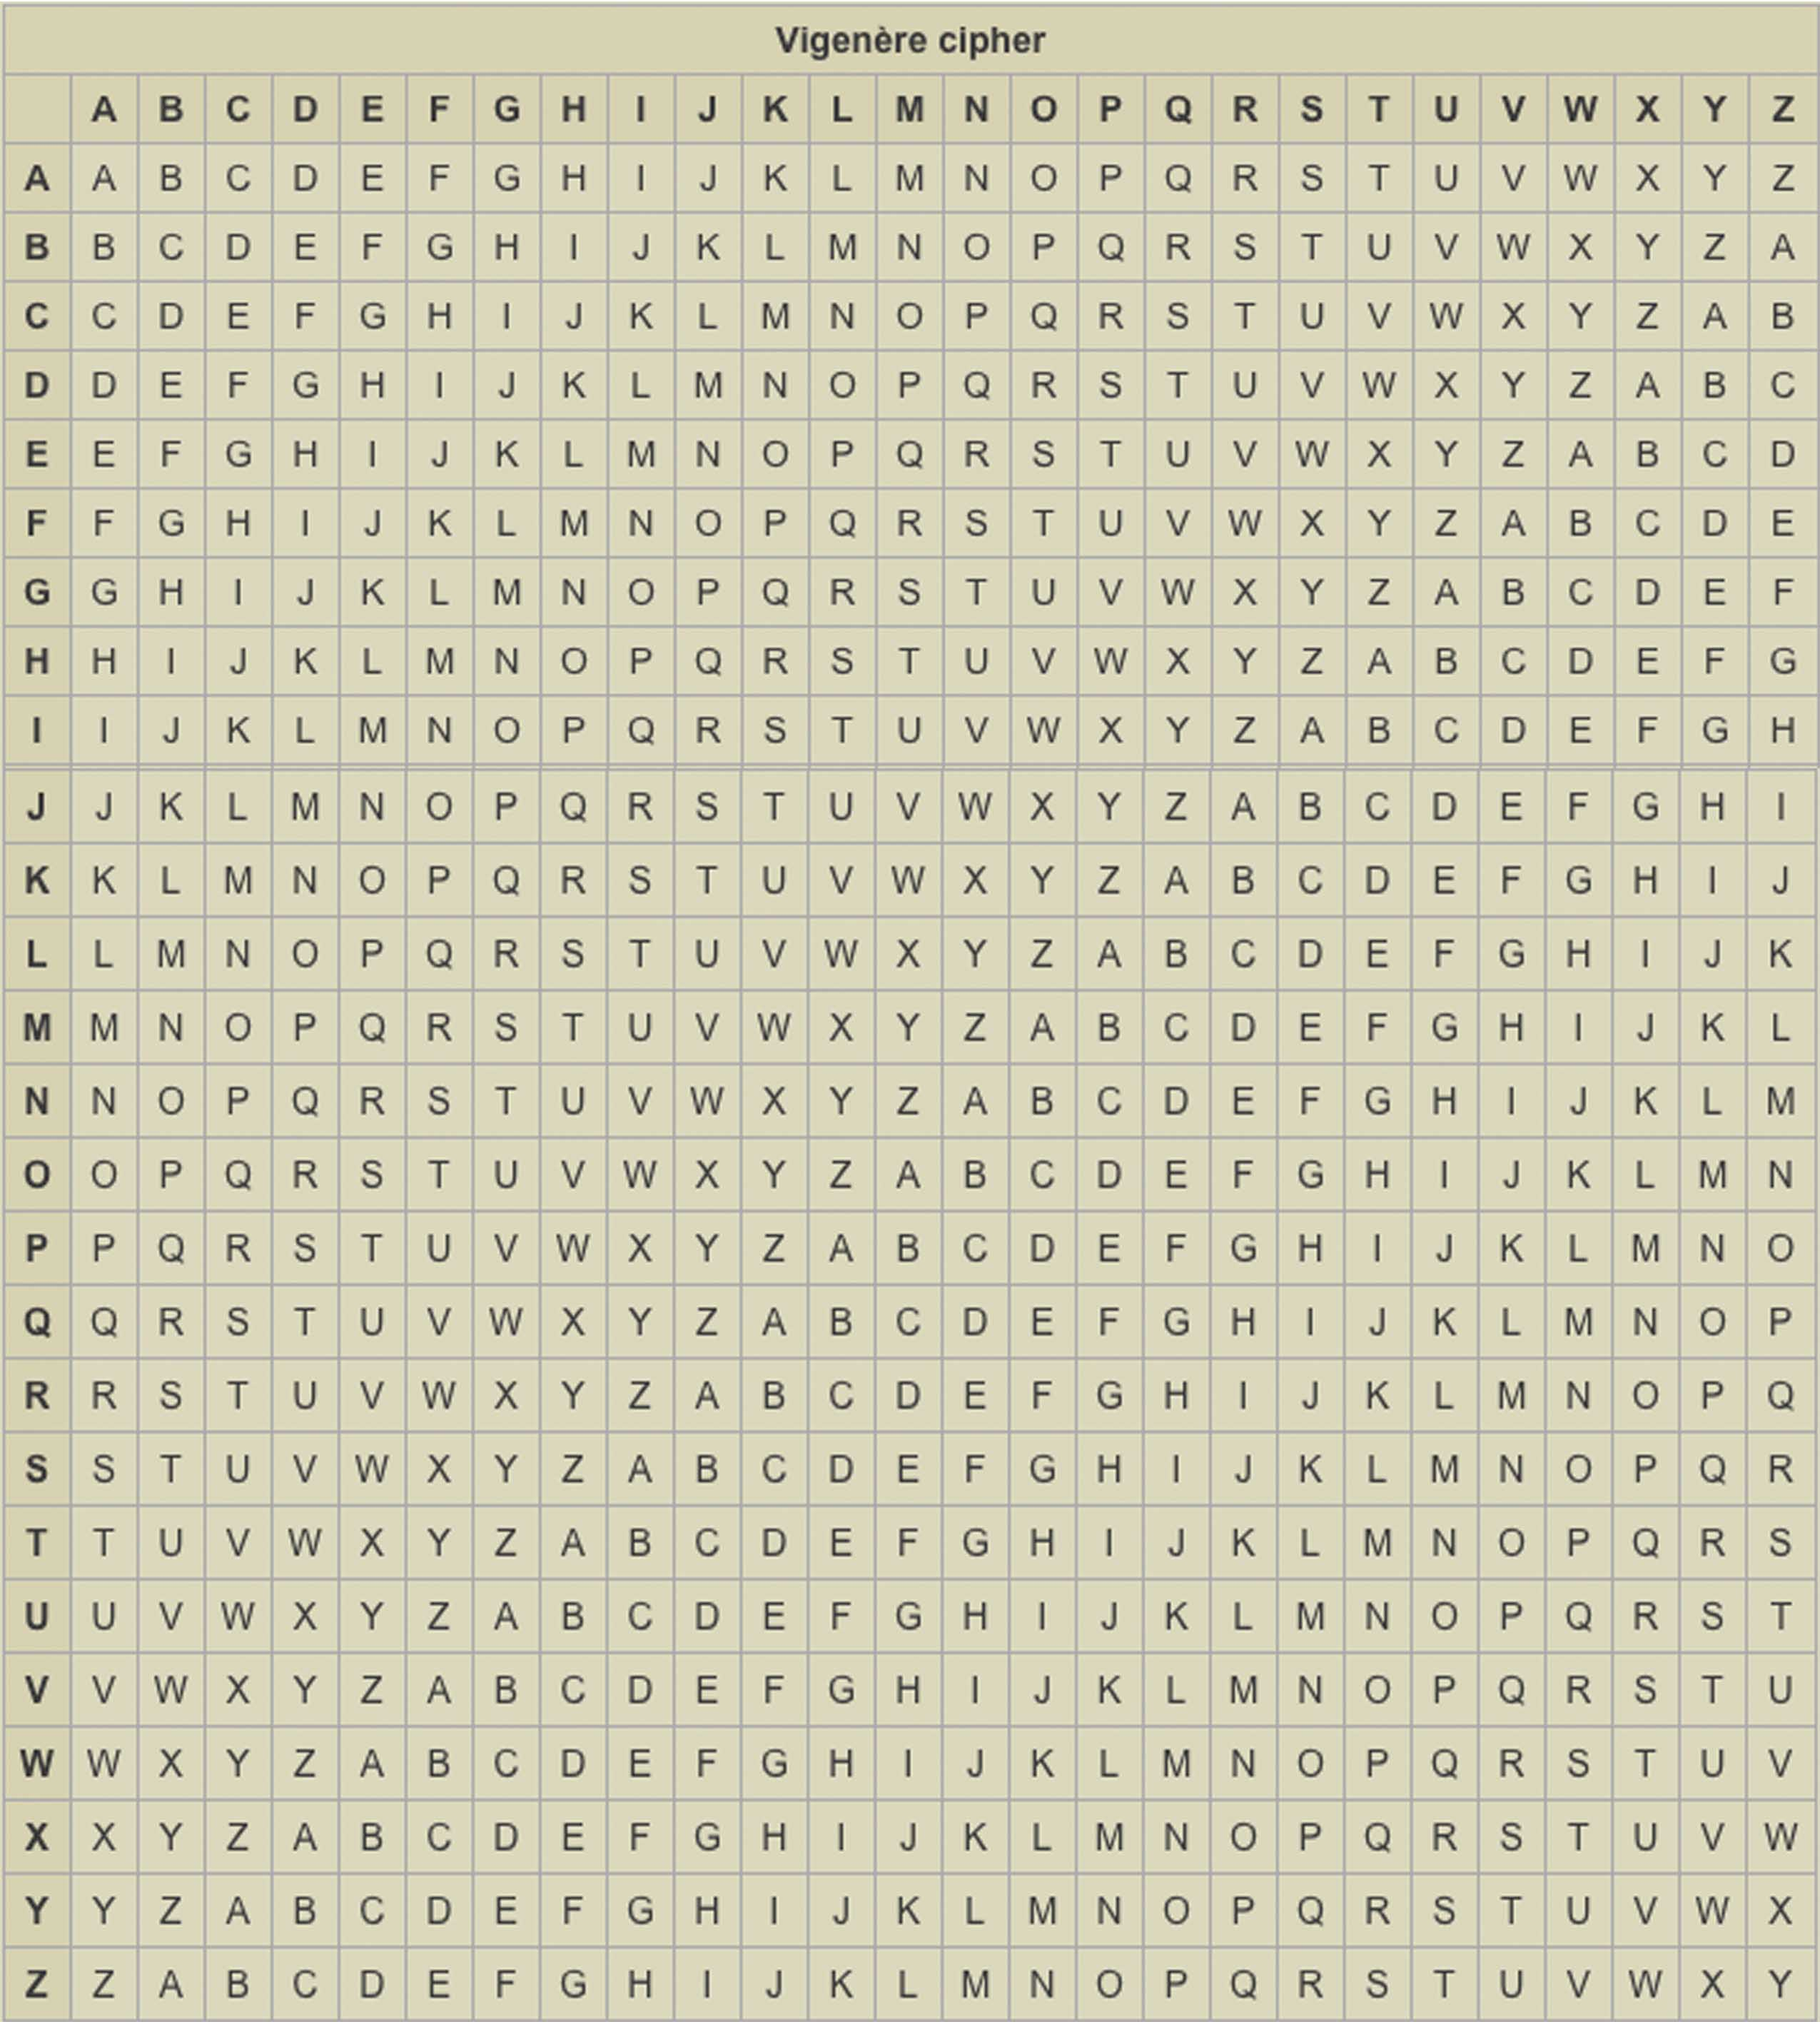
Vigenere Matrix
7
256 x 256 for Plain Text
Specific Serial of Data in Row and Column
Square Matrix
Data Serial to be Adjusted for Numerical Data

Slide 8
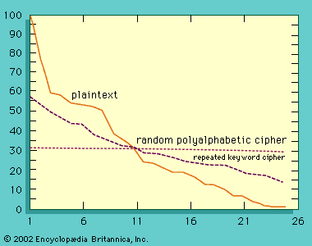
Mathematical Operations

Slide 9
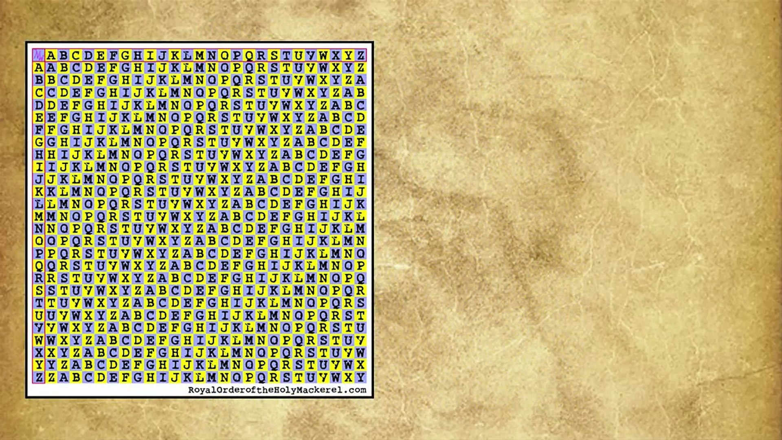
Step 1
Generate Vigenere Matrix

Slide 10

Step 2
Set Key Length = Text Length

Slide 11
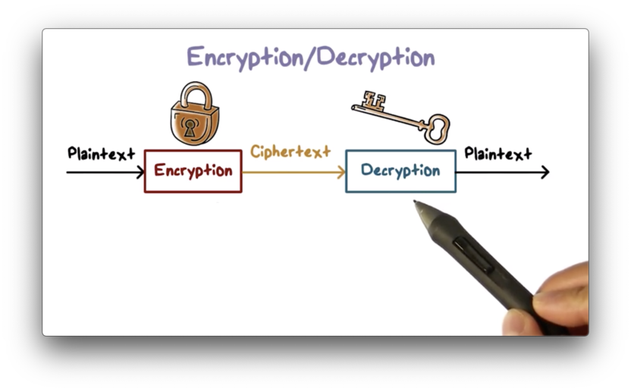
Step 3 (Encryption)
Cipher(x) = Vigenere (Key(x), Text(x))

Slide 12
Step 4 (Decryption)
Text(x) = Cipher(x) – key(x) +1

Slide 13

Implementation in Matlab
Image Encryption
Find the full code here: https://github.com/RHassan1609/Encryption-and-Decryption-of-Secret-Data-by-Forming-Cipher-Text/blob/main/EncryptionImage.m
Text Encryption
Find the full code here: https://github.com/RHassan1609/Encryption-and-Decryption-of-Secret-Data-by-Forming-Cipher-Text/blob/main/EncryptionText.m

Slide 14
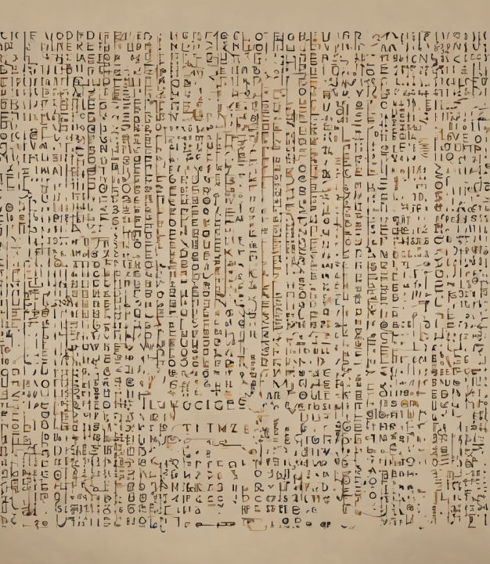
Can Encrypt Almost All Types of Input Data
No Specific Criterion Required for Input
Advantages
&
Disadvantages
More Complex than Other Ciphers.

Slide 15


